Slide 1
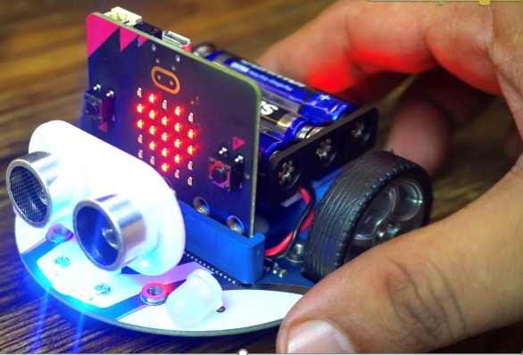

INTRODUCTION TO ROBOTICS WITH MICRO:BIT
DAY 2
Oct 6th ,2026
Dr.Abinaya Inbamani
Post Doctoral Associate

Slide 2
The 4-H Pledge ​
​
I pledge my head to clearer thinking, ​
My heart to greater loyalty, ​
My hands to larger service, ​
And my health to better living, ​
For my club, my community, ​
My country, and my world.

Slide 3
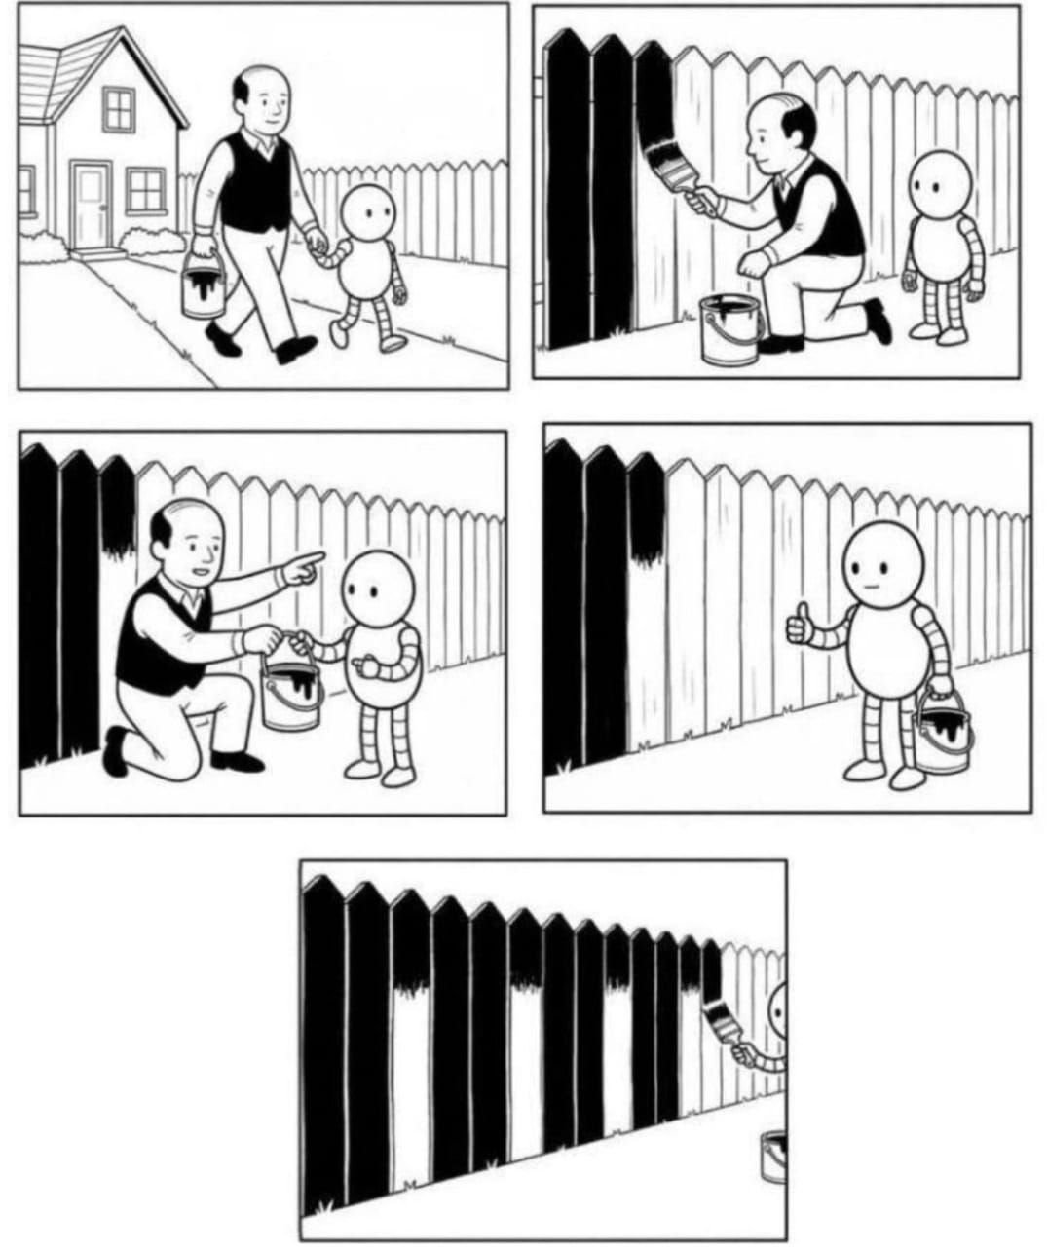
HUMANS VS. ROBOTS
Humans
Input: We use our eyes, ears, and sense of touch to observe our surroundings.
Processing: Our brain decides what action to take.
Output: Our hands and feet control the steering wheel, brakes, and accelerator.
Robots​
Input: Sensors collect information from the environment. ​
Processing: The microcontroller (brain) analyzes the information. ​
Output: Motors and actuators perform the required action​
​

Slide 4
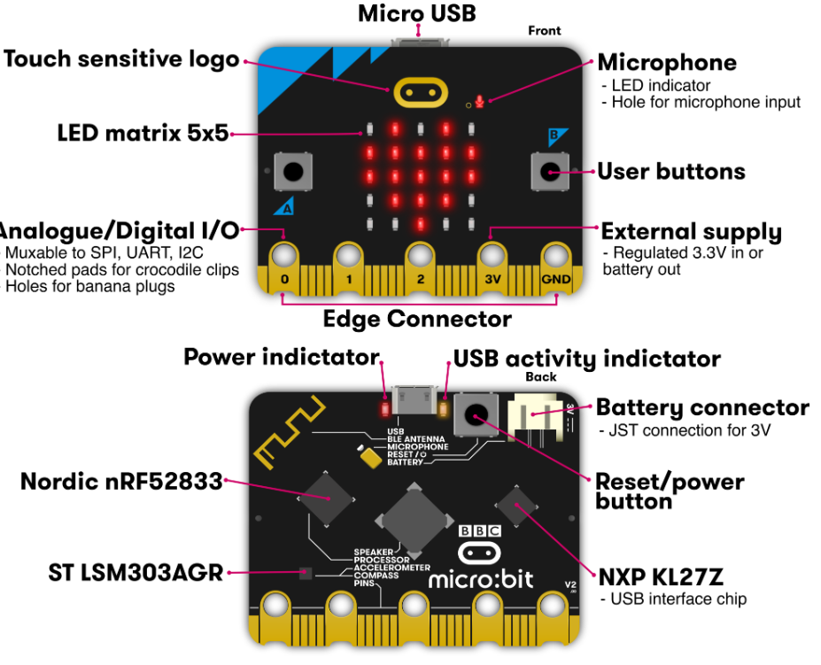
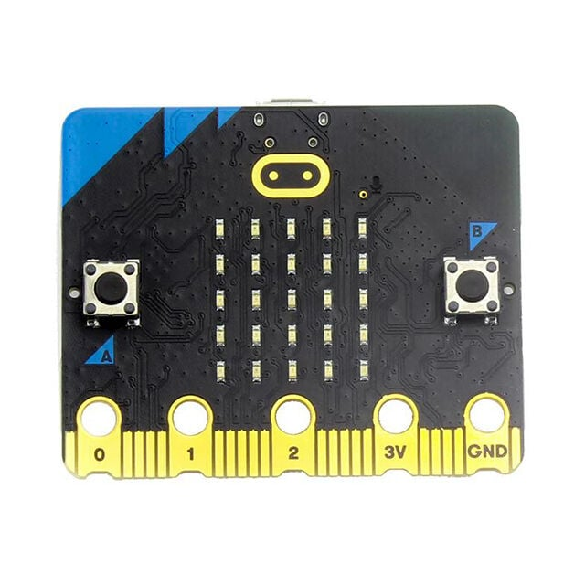
MICROBIT
The micro:bit is a pocket-sized programmable computer with built-in sensors, buttons, LEDs, and wireless communication that can be used to create interactive projects and control robots.

Slide 5
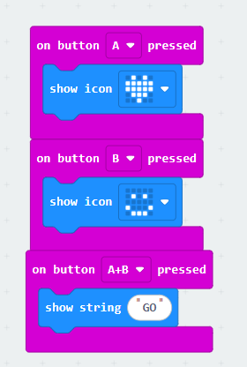
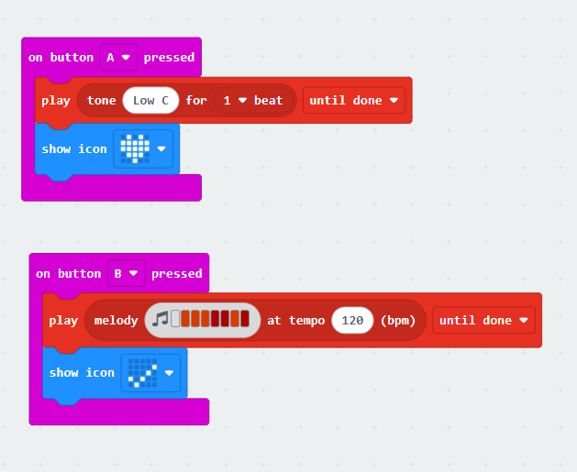
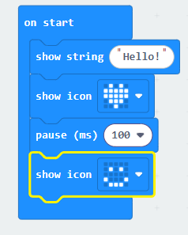
MICRO:BIT V2 ACTIVITIES
Display Text and Icons
Buttons as Inputs
Speaker—Sounds and Melodies

Slide 6
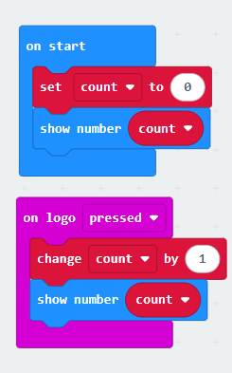
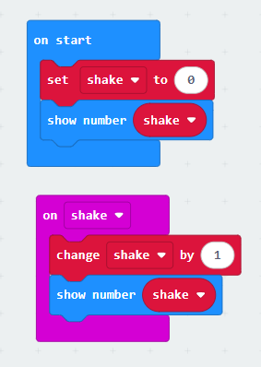
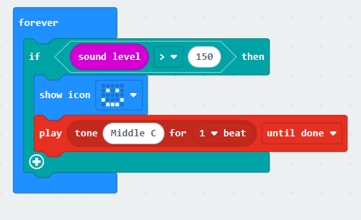
micro:bit V2 Activities
Logo Touch Counter
Shake Counter
Clap Detector
The Logo Touch is a built-in capacitive touch sensor on the front of the micro:bit V2.
An accelerometer is a sensor that measures the movement and orientation of the micro:bit.
The built-in microphone helps to detect loud sounds and trigger an action.

Slide 7
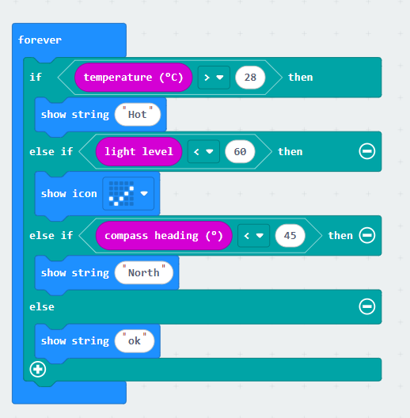
micro:bit V2 Activities
Multi-Sensor Monitoring System
A compass heading uses:
North: 0° or 360°
East: 90°
South: 180°
West: 270°

Slide 8
RADIO IN A MICROBIT
The radio in a micro:bit allows one micro:bit to send information wirelessly to another micro:bit. It works a little like a walkie-talkie.
If two micro:bits are using the same radio group, they can send and receive messages, numbers, or sensor data.
For example, one micro:bit in a field could send “WATER”, and another micro:bit at a farm office could receive and display that message.

Slide 9
SIGNAL STRENGTH IN A MICROBIT
Signal strength tells us how strong the wireless connection is between two micro:bits.
If the micro:bits are close to each other, the signal is usually stronger. As they move farther apart, or if walls and other objects are between them, the signal may become weaker.
  Signal strength is like how clearly you can hear someone talking. If they are close, you hear them clearly. If they move far away, their voice becomes weaker. Radio signals behave in a similar way.
On the micro:bit, signal strength is usually shown as a negative number.
For example:
−35 = strong signal
−60 = medium signal
−90 = weak signal
The important rule is:
  The number closer to 0 means a stronger signal.

Slide 10
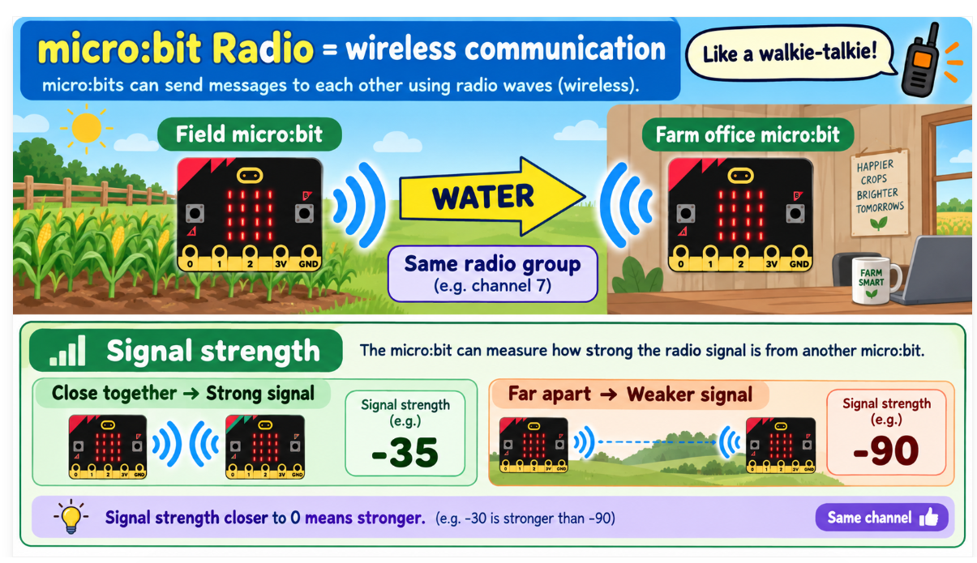

Slide 11
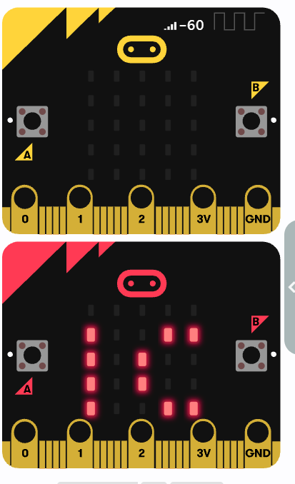
MICRO:BIT V2 ACTIVITIES
Experiment 1 — Smart Farm Worker Communication
Use two micro:bits to send simple farm messages wirelessly.
Example:
Button A → WATER
Button B → DONE
A+B → HELP
Concept: radio set group + radio send string + on radio received
Agriculture Link: Helps workers communicate quickly without walking back to a central location.

Slide 12
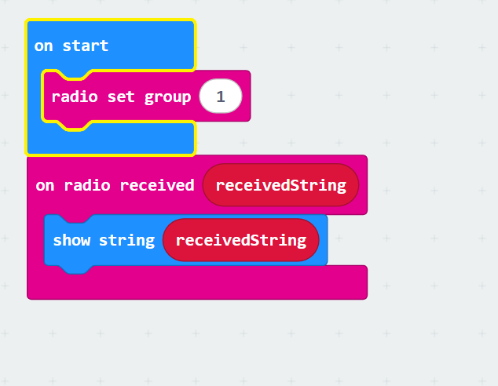
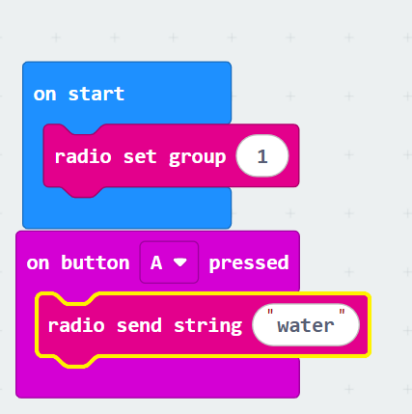
Sender
Receiver

Slide 13
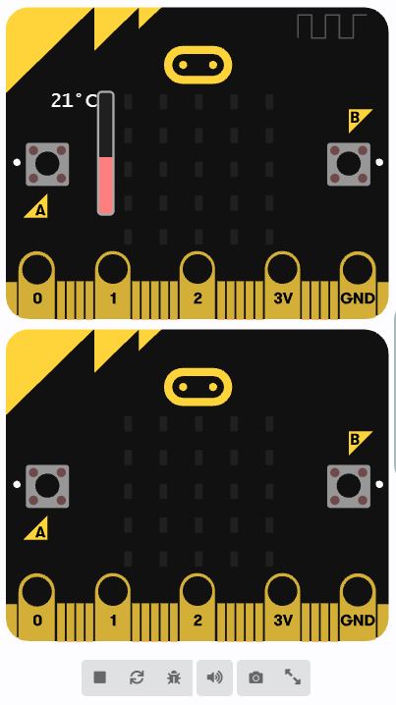
MICRO:BIT V2 ACTIVITIES
Experiment 2 — Remote Farm Data Station
Use one micro:bit to send a numerical sensor reading to another micro:bit.
Example:
Send the micro:bit temperature reading every few seconds.
Concept: radio send number + on radio received number
Agriculture Link: Allows environmental data to be monitored remotely, reducing repeated manual checking.

Slide 14
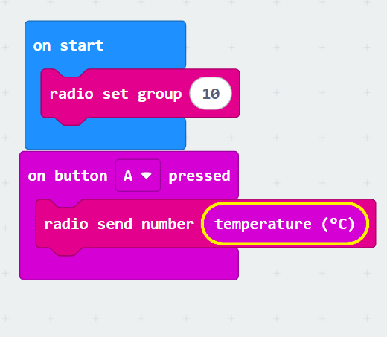
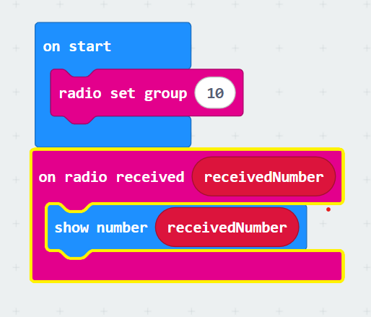
Sender
Receiver

Slide 15
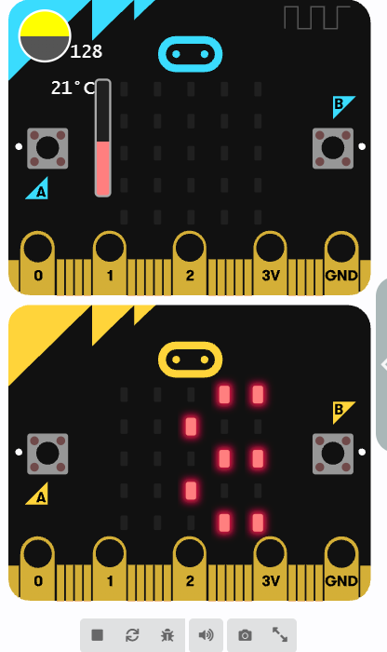
MICRO:BIT V2 ACTIVITIES
Experiment 3 — Smart Farm Sensor Network
Send both the sensor name and its value so the receiver knows what the data represents.
Concept: radio send value + on radio received name value
Agriculture Link: Multiple farm conditions can be sent to one monitoring station for easier decision-making.

Slide 16
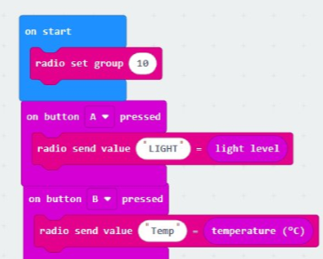
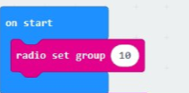
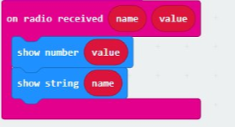
Sender
Receiver

Slide 17
Experiment 4 — Radio Signal Strength Test
One micro:bit acts as the sender and continuously sends the number 1 every 5 seconds on Radio Group 10. A second micro:bit, set to the same radio group, receives the message and displays the signal strength of the received radio packet.
Students can keep the two micro:bits at the same distance and place different materials between them, such as a book, water bottle, cardboard, or metal object. They can record how the signal strength changes.
Remember:
Closer to 0 = stronger signal
More negative = weaker signal
Agricultural Connection: Wireless sensors placed around farms, greenhouses, or barns may experience weaker signals when walls, water, plants, or equipment are between devices. This experiment helps students understand how the environment can affect wireless communication.

Slide 18
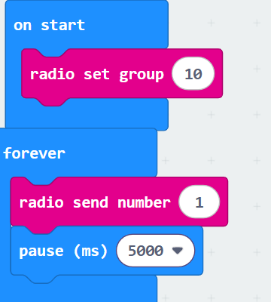
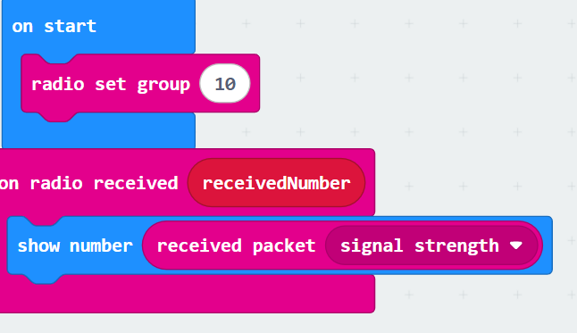
Sender
Receiver

Slide 19
